Slide 1
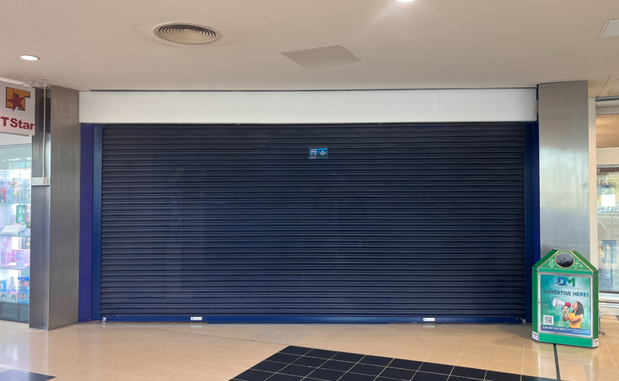
Unit 3, Clarehall Shopping Centre, Co. Dublin
Unit 3, Clarehall Shopping Centre, Malahide Road, Co. Dublin
To let
Property Highlights
      Ground floor retail unit located next to Holland & Barrett
      Extending to approx. 667 sq. ft (61.97 sq. m)
      Situated within the well-established Clarehall Shopping Centre
      Anchored by a high-performing Tesco Extra
      Strong tenant mix including Eason’s and McCabes Pharmacy.
Contact
Conor Niland
Email: conor.niland@cushwake.com
Tel: +353 1 639 9219
Max Harrington
Email: Max.harrington@cushwake.com
Tel: +353 86 817 3854
Location
Clarehall Shopping Centre is located approximately 9 km north-east of Dublin City Centre along the Malahide Road, serving a large residential catchment including Clarehall, Donaghmede and Balgriffin. The centre benefits from strong accessibility and provides approximately 880 customer car parking spaces.

Slide 2
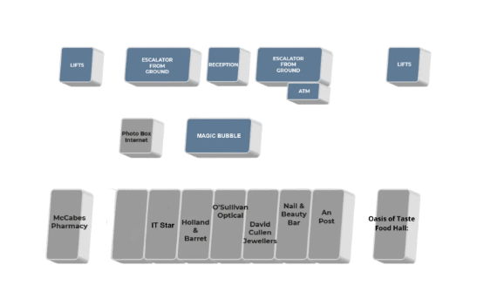
Unit 3, Clarehall Shopping Centre, Malahide Road, Co. Dublin
Property Description
Unit 3 Extends to approx. 667 sq. ft (61.97 sq. m) within Clarehall Shopping Centre. The scheme is anchored by Tesco which will benefit the unit from strong footfall.
Viewings
Strictly by appointment only through sole leasing agents Cushman & Wakefield.
Rent
Quoting rent is at €30,000 per annum.
Service Charge
Service Charge for this property is approximately €5,999 per annum.
BER: TBC
Insurance
Insurance for this unit is TBC.
Rates
We are advised the commercial Rates for this property are approximately €3,717 per annum.
Unit 3

